Slide 1

#HotSpot
A Real Time Big Data Processing System of Tweets via Keywords & GPS Locations
Preliminary Design Review (PDR)
October 24th, 2016
ECE 480

Slide 2
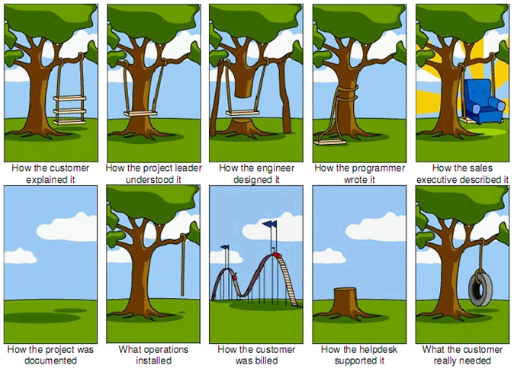
Good Morning!
Notes:
kevin

Slide 3
Project Organization
Presenters | Role
Brad Ko Kevin Chew Figueroa Peter Stretch Juan Robles Steven Chung Greg Lynch | Project Manager Software Engineer Lead Test Engineer Software Engineer Software Engineer Software Engineer
Notes:
kevin
Slide Instructions:
Identify the individuals present during the presentation indicating their role and/or organization. Please note that the Business Owner must be present.

Slide 4


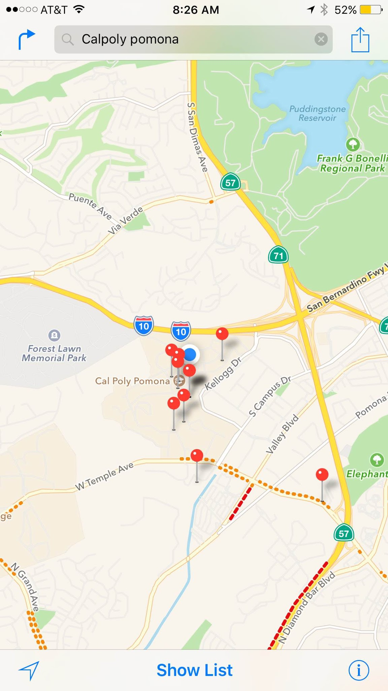
Concept of Operation
Keywords
#HotSpot
Notes:
Kevin

Slide 5
Architecture Design
Tweets
TembooSession
setAccessToken(accessToken);
setAccessTokenSecret(accessTokenSecret);
setConsumerSecret(APISecret);
setConsumerKey(APIkey);
setGeoCode(GPS);
setup();
searchTweets(String query);
printTweetsResults(String r);
setupTwitterSearch();
ArrayList
TweetsResultSet
tweetsResults = twitterSearch.run();
twitterSearch.setQuery(q);
twitterSearch.setCount("200");
getResponse();
getRemaining();
Notes:
Kevin

Slide 6
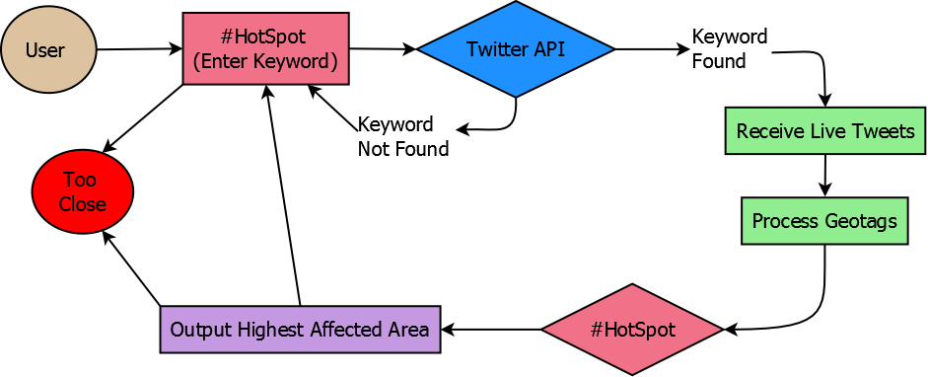
High Level Business Concept
Notes:
steven

Slide 7
Project Information
Business Need
Businesses are able to meet their consumer’s needs by location. News channels are able to keep up with popular trends and find out more about what’s going on in their local community through a quick search.
Goals/Scope/Purpose
To find the most condensed areas of the user’s desired keyword via Tweets
Stakeholders
Fox News Channel - $2k at 8%
Cable News Network (CNN) - $4k at 11%
National Security Agency - $4k at 11%
Cloud Services
The system will continue to use the services provided by Twitter API
Notes:
Peter

Slide 8

Proposed System
Functional Requirements
Filter for Tweets with a location
User-inputted keywords will be applied to filtered tweets
Filter out Tweets that are outliers in the location density analysis of the data.
Output the area where the keyword is trending the most
Non-Functional Requirements
Shall provide a stable and reliable WebSocket connection to Twitter using its API
Have the GPS results continuously updated at maximum/worst every 5 seconds
Provide a handler (for all user inputs) for exceptions
Notes:
Juan

Slide 9

Proposed System
Summary of Changes
Initially the system was to include a density model mapping the GPS location of tweets matching the user’s search Query.
However, further investigation of Twitter’s API, shows their services do not return precise GPS location information. Thus this model will not be provided in our system.
Notes:
Juan

Slide 10

Design Considerations
Goals and Guidelines
Obtain partnership with Twitter for further development
Ensure that users have quality customer service
Provide updates to software from user feedback
Development Methods and Contingencies
Refine clustering method for heatmap generation
Provide streaming of user data to prevent botting (fake iterations)
Provide cache of hotspot locations for future keyword searches
Filter tweets from authenticated and non-authenticated users
Architectural Strategies
Provide means of streamlining keyword search process (recent searches)
Increase number of hits from Twitter feeds (popularity consistency)
Provide passive heatmaps from previous #HotSpots
Notes:
Greg

Slide 11

Schedule Overview
Oct. 31 - Establish stable connection with Twitter and their database
Nov. 9 - Store related Tweets in a queue to be processed
Nov. 11 - Holiday. #HotSpot team members’ day off
Nov. 14 - Test the range of the incoming Tweets from a given location
Nov. 23 - Create a GUI for applications for #HotSpot
Nov. 24-25 - Have a great Thanksgiving, #HotSpot team members!
Nov. 30 - Public release of #HotSpot
Notes:
Brad

Slide 12

Risk Assessment
There is no risk of hardware unavailability due to no specific hardware required (app-based)
Due to the fact that Twitter is an online social media, if it goes offline, #HotSpot will not operate [failure to connect to the websocket]
Misuse of intended purpose (stalking)
Temptation of distribution for profit
Notes:
Brad
Possible Risks:
Misuse of software to stalk an individual
possible solution?
the API doesn’t give the exact location
state in the terms of service that stalking is not prohibited

